Slide 1




Restaurant Recommendation system
Aditya Patil - 240343025002
Bhavnesh Sharma - 240343025009
Kaushik Kedari - 240343025021
Shrikant Gaikwad - 240343025046
Shweta Wable - 240343025047
Guided By:
Ms. Trupti Joshi
Mr. Prasad Deshmukh

Slide 2
TABLE OF CONTENTS
1. INTRODUCTION
2. PROBLEM STATEMENT
3. DATASET
4. DATA PREPROCESSING
5. SYSTEM ARCHITECTURE
6. MODEL
7. CONCLUSION

Slide 3
INTRODUCTION
The significance of personalized restaurant recommendations has risen as a result of a rapid rise in online dining preference searches.
89% of consumers research dining options on mobile devices before visiting a restaurant and 79% use Google for dining decisions, and 48% rely on social media for food and drink recommendations
Need Of Personalized restaurant recommendations.
In this project, we aim to deliver a Restaurant Recommendation
System with Big Data, Machine Learning, and Cloud Integration.
A. Real-time Dining Suggestions
B. Personalized Restaurant Picks

Slide 4
Problem Statement
In today’s digital age finding the right restaurant among countless options can be overwhelming and time-consuming.
Traditional search methods often fail to provide personalized results, leading to unsatisfactory dining experiences.
The Restaurant Recommendation System addresses this issue by utilizing Big Data, Machine Learning, and cloud technologies to offer real-time, tailored restaurant suggestions that match users' preferences and needs.
4

Slide 5
About Dataset
YELP dataset is a subset of our businesses, reviews, and user data for use in connection with academic research.
The data is available in Json file format.
This dataset contains 1.5M Businesses data, 7M Reviews data, 2M Users data, 1.2M Check-ins data, 1.5M Tips data.
The Data describes attributes as follows :
a. business.json: business id, name,address,city,postal code,state,lat,long
b. review.json: review text, star ratings, and helpfulness votes
c. user.json: information about users, their review count, average ratings.
d. Check-ins.json : timestamps and user counts
e. Tips: Features brief user-generated tips and advice related to businesses

Slide 6
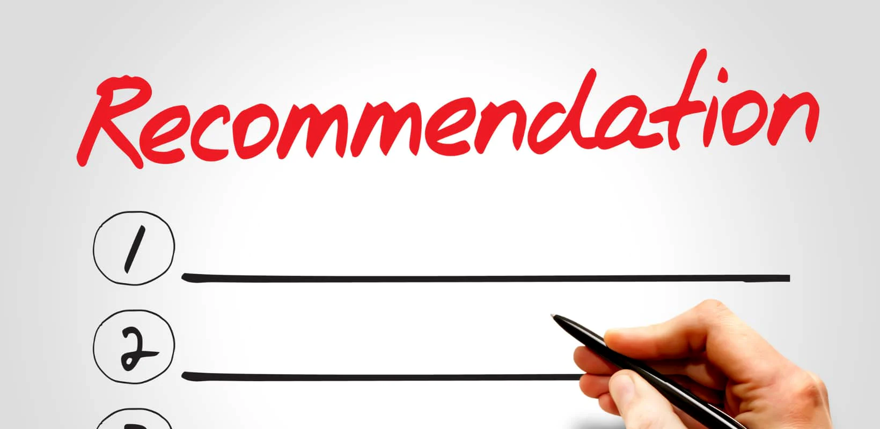
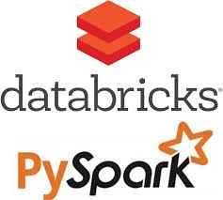
System Architecture
YELP
Dataset
Azure Containers
Pipeline using Azure Data Factory

Slide 7
Data Pre-Processing
Loading data into AZURE container
Extracting relevant Businesses ID from business table related to restaurant using filter on category.
Restaurant ID
Businesses
Reviews Table
Final Table
Users Table

Slide 8
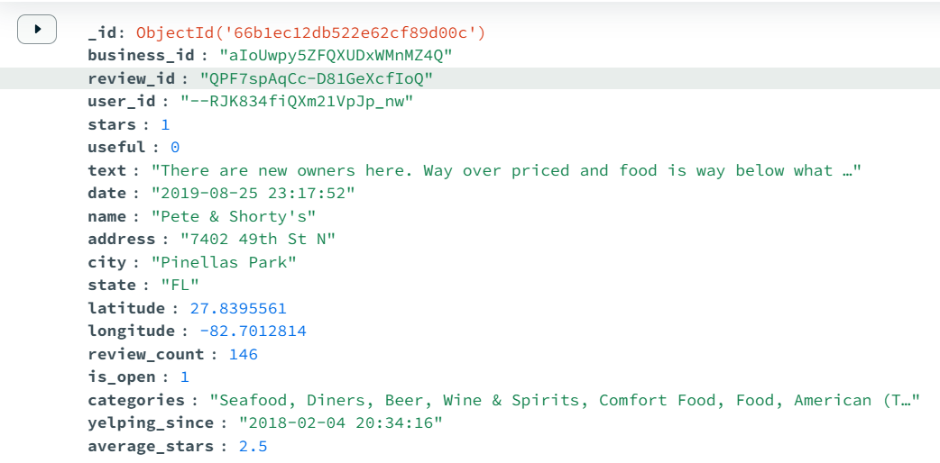
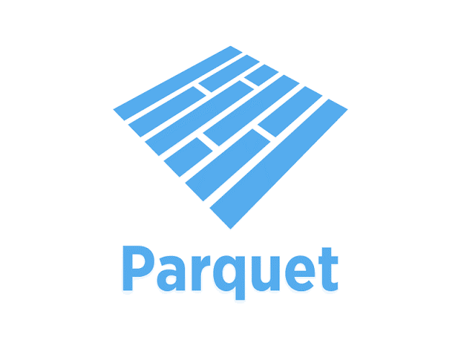

JSON tables are Converted into Parquet
Alphanumeric columns are converted into numeric values.

Slide 9
ALS (Alternating Least Squares)
Matrix factorization technique used in collaborative filtering.
Decomposes user-restaurant interaction data into latent factors
Generates personalized recommendations
Highlights trending restaurants with high reviews and strong ratings.
A~ U×V
A original data
U user data
V resturant data

Slide 10
Model Demo

Slide 11
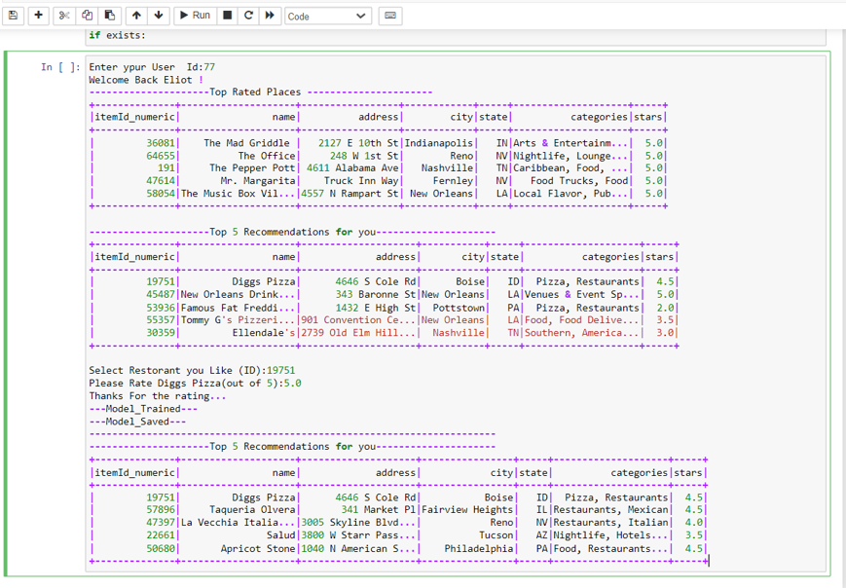
Model Output

Slide 12
Future Scope
Scalable Data Architecture: Enhance the system's scalability to handle larger datasets, potentially integrating more comprehensive data sources such as entire Yelp dataset, social media activity, weather patterns, and event schedules to refine recommendation accuracy
Advanced Predictive Analytics: Use advanced predictive analytics with Big Data technologies like Apache Spark and Hadoop to forecast trends in the restaurant industry, such as emerging cuisines or popular dining times, and incorporate these insights into the recommendation system.

Slide 13
Conclusion
Our Restaurant Recommendation System successfully uses Big Data and Machine Learning to provide personalized dining suggestions. By applying the ALS algorithm, we tailored recommendations based on user preferences and location. Tableau was used to visualize trending restaurants, combining review counts with average ratings. This project not only improves user experience but also offers valuable insights for restaurant owners, showcasing the practical application of advanced data technologies in the restaurant industry
13

Slide 14
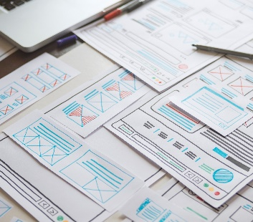
Thank you

